Slide 1
ARTIFICIAL INTELLIGENCE & MACHINE LEARNING
UNIT I

Slide 2
Learning Objectives
AI Fundamentals:
Defining Artificial Intelligence
Types of AI
Turing test
Defining AI techniques
Comparison - AI, ML and Deep Learning
Problem characterization and reduction
Defining State Space
AI Search Techniques (Hill Climbing, Breadth first and depth first search, Best first search, A*, AO*, Constraint Satisfaction)
MEA
Ethics of AI

Slide 3
Artificial Intelligence
Artificial Intelligence (AI) is a set of technologies that enable computers to perform a variety of advanced functions, including the ability to see, understand and translate spoken and written language, analyze data, make recommendations, and more.
Alan Turing (Father of Computer Science) asks the question
“Can Machine Think?”
He Also offers a famous test “Turing Test” where a human interrogator would try to distinguish between computer and human text response.

Slide 4
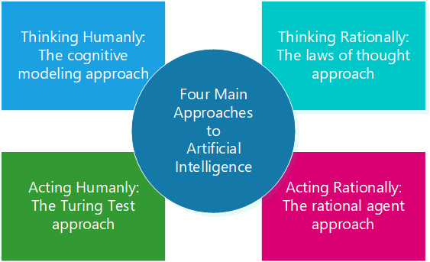
Artificial Intelligence (contd.)

Slide 5
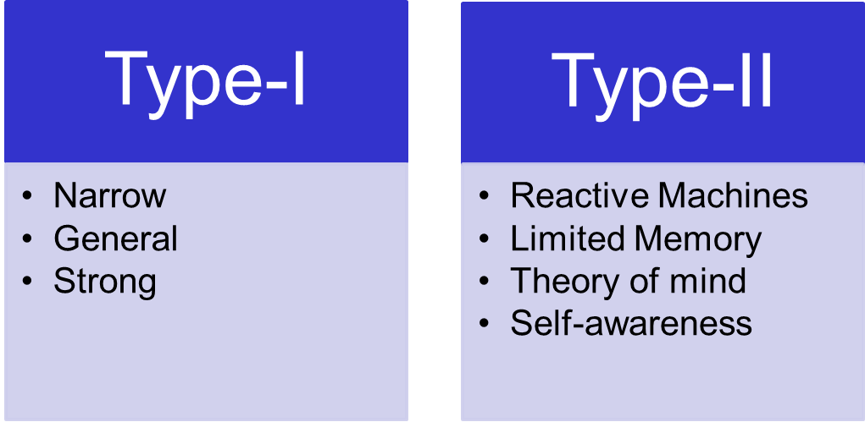
Types of AI
Based on the capability and functionality, there are two types of AI:
Type-I
Type-II

Slide 6
Types of AI- Based on Capabilities
Narrow/Weak AI:
Able to perform dedicated task with intelligence.
This is the most common AI.
It is only trained for one specific task only.
e.g. Apple Siri, self-driving cars
General AI:
It can perform any intellectual task with efficiency like a human.
No such system exist till now which can be smarter and think like a human by its own.
Super AI:
A level of intelligence of a system where the machine could surpass human intelligence and can perform task better than human.
It can be outcome of general AI.
Commute by its own, make judgement, solve the puzzle.

Slide 7
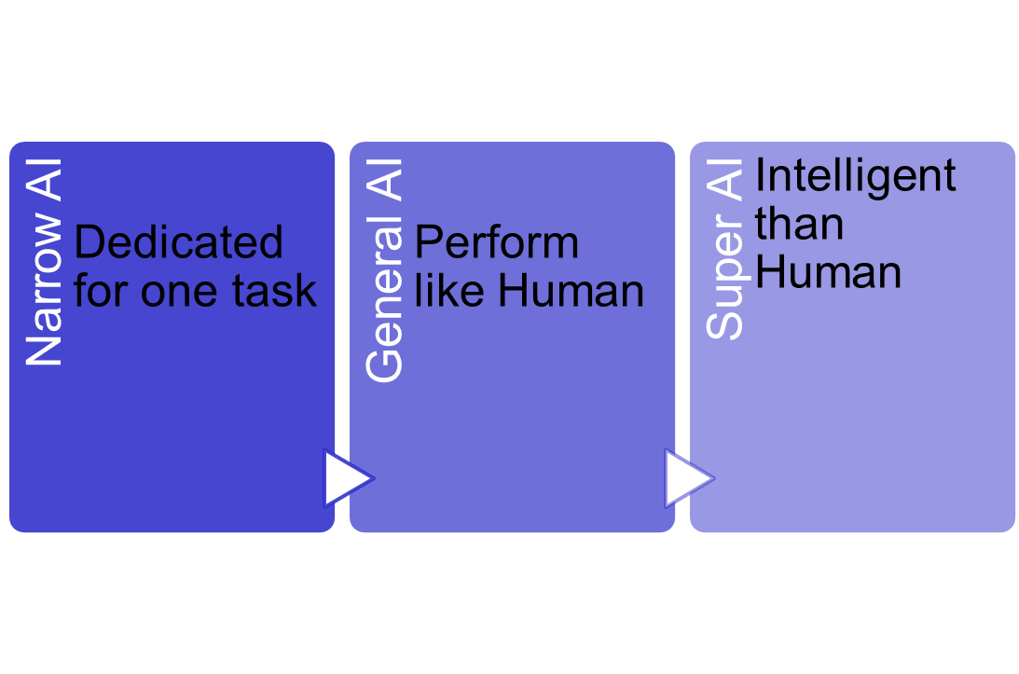
Types of AI- Based on Capabilities (contd.)
We are here

Slide 8
Types of AI- Based on Functionality
Reactive Machines
Most basic types of AI
They do not store memories or past experiences for future actions.
Only focuses on current scenarios
e.g. IBM Deep Blue (a chess playing super computer)
Limited Memory
This can store past experience for short period of time.
e.g. self driving cars🡪 can store speed and distance of nearby cars to navigate the roads.
Theory of mind
This understand the human emotions, people, beliefs and able to interact socially like humans.
Self-Awareness
It is the future of AI.
These machines will be super intelligent.
They will have their own sentiments and self awareness.

Slide 9
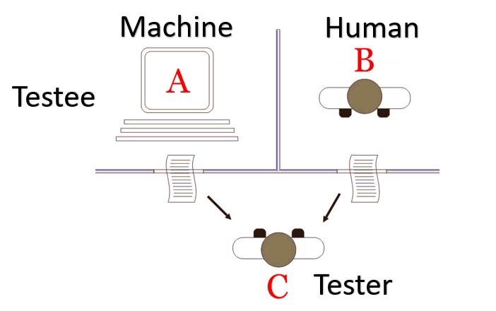
Turing Test
Developed by Alan Turing in 1950.
He proposed that whether or not a computer (machine) can think intelligently like humans?
He engages both a human and a machine in a text based conversation and then decides which of the two they believe to be human.
If the judge (human) unable to distinguish between the human and the machines based on the conversation, then the machine is said to have passed the Turing test.
This tests evaluate the machine intelligence for over six decades.

Slide 10
Turing Test today
The Turing Test has its detractors, but it remains a measure of the success of artificial intelligence projects. An updated version of the Turing Test has more than one human judge interrogating and chatting with both subjects. The project is considered a success if more than 30% of the judges, after five minutes of conversation, conclude that the computer is a human.
The Loebner Prize is an annual Turing Test competition that was launched in 1991 by Hugh Loebner, an American inventor and activist. Loebner created additional rules requiring the human and the computer program to have 25-minute conversations with each of four judges. The winner is the computer whose program receives the most votes and the highest ranking from the judges.
In 2014, Kevin Warwick of the University of Reading organized a Turing Test competition to mark the 60th anniversary of Alan Turing’s death. A computer chatbot called Eugene Goostman, who had the persona of a 13-year-old boy, technically passing the Turing Test in that event. He secured the votes of 33% of the judges who were convinced that he was human.
In 2018, Google Duplex revealed the capability to performing tasks via the telephone. In various demonstrations, Duplex schedule a hair appointment as well as called a restaurant, with the human on the other end of the line not realizing they were interacting with a machine. However, critics point out that the interaction does not conform to the actual Turing test and claim the test has still yet to be beaten by a machine.

Slide 11
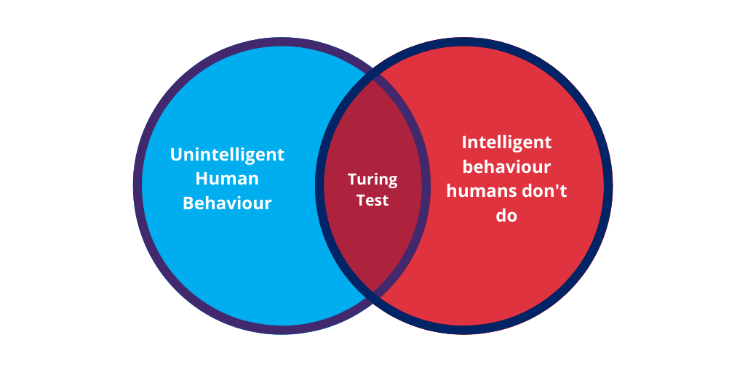
Limitations of Turing Test
It focuses primarily on language-based conversation and not taking into account other important aspects such as problem-solving, perception, decision-making etc.
The results of the test can be influenced by the biases, making it difficult to obtain objectives and reliable results.
May not be suitable to test for intelligence as different computing systems are structured differently.

Slide 12
Defining AI Techniques
AI techniques revolutionizing the way humans interact with technology.
Depending on the machine’s ability to utilize past experiences to anticipate future judgments, memory, and self-awareness, artificial intelligence can be classified into a variety of subcategories.
Following are the four broad types of AI Techniques:
Machine Learning (ML)
Natural Language Processing (NLP)
Machine Vision/Computer Vision
Automation and Robotics

Slide 13
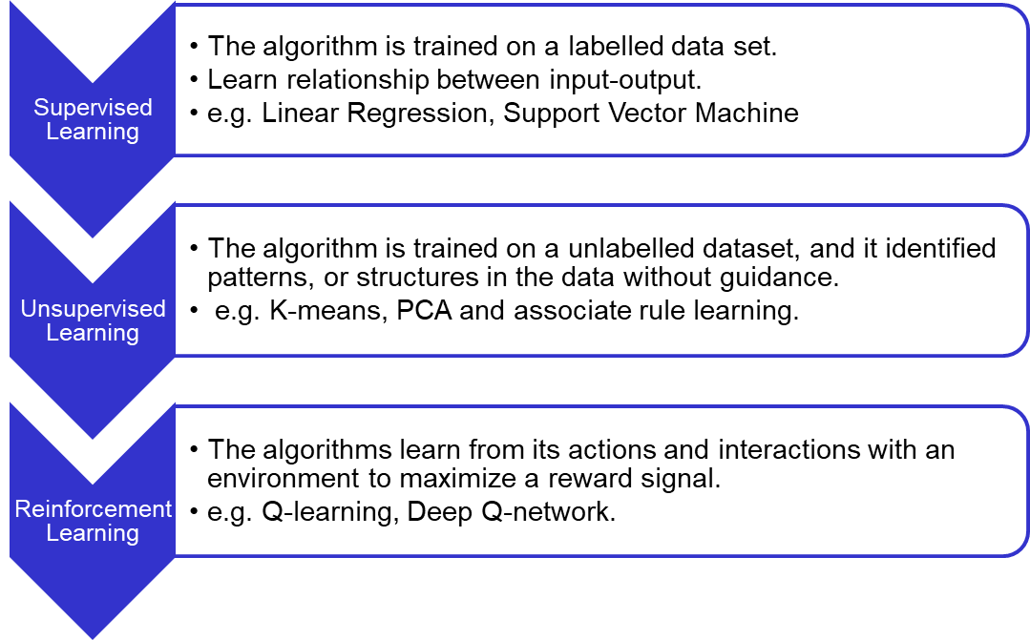
Machine Learning (ML)
A subset of AI that uses statistical methods to enable machines to learn from data.
It involves the creation of algorithms that can identify patterns, make predictions and improve their performance over time without explicit programming.

Slide 14
Natural Language Processing (NLP)
A subfield of AI that focuses how machine understand, interpret and generate human language.
e.g. Speech Recognition, Chatbots, Sentiment analysis
It involves the use of computational techniques to process and analyze natural language data, such as text and speech, with the goal of understanding the meaning behind the language.
Some commonly used techniques in NLP are:
Machine translation
Text classification
Part-of-speech tagging
tokenization
Challenge : ambiguity and complexity of human language; similar word can have different meaning in multiple language.

Slide 15
Machine Vision/Computer Vision
A field of AI that involves training machines to interpret and understand visual data from the world around us.
Analyze visual data, such as images or videos and identify patterns and objects within them.
Machine vision, paired with AI and deep learning, expands the role of robots in performing production-line tasks, such as picking, sorting, placing and performing a manufacturing line scan

Slide 16
Automation and Robotics
Involves the use of technology to perform tasks that would otherwise be performed by humans.
Automation is a process that uses software, machines, or other technology to carry out tasks in place of human workers.
Robotics is a field that combines engineering and computer science to design and build robots to perform tasks.
Differences Between Automation and Robotics!!!

Slide 17
AI, ML and Deep Learning
Deep learning and machine learning are subsets of AI wherein AI is the umbrella term. Each of these technologies can create smart applications. Companies can use machine learning, deep learning, and artificial intelligence for several projects.
Goal:
AI: To make machines as smart as humans.
ML: To make machine learn without explicit programming
DL: To mimic the human brains and make accurate predictions
Data Handling:
AI: deals with structured, semi-structured and unstructured data.
ML: Structured and semi-structured data
DL: Structured and unstructured data

Slide 18
AI, ML and Deep Learning (Contd.)
Types of algorithm
AI: uses types of algorithm that reflects intelligence through decision-making
ML: employs an algorithm that enables the system to learn from data
DL: algorithm that includes a neural network to analyze data and outcomes.
Applications
AI: ride sharing, auto pilot and online games.
ML: pattern recognition, fraud detection, content recommender system.
DL: stock market trading applications, medical diagnosis, customer support applications.

Slide 19
Problem characterization
AI is a way of making a computer or machine or a software thinks intelligently in the similar manner the intelligent humans think.
We must have a method to choose the best possible solution.
To choose appropriate method for a particular problem we need to categorize a problem.

Slide 20
Problem characterization and Reduction (Contd.)
Decomposability of the problem into a set of independent smaller subproblems
Possibility of undoing solution steps, if they are found to be unwise
Predictability of the problem universe
Possibility of obtaining an obvious solution to a problem without comparison of all other possible solutions
Type of the solution: whether it is a state or a path to the goal state
Role of knowledge in problem solving
Nature of solution process: with or without interacting with the user

Slide 21
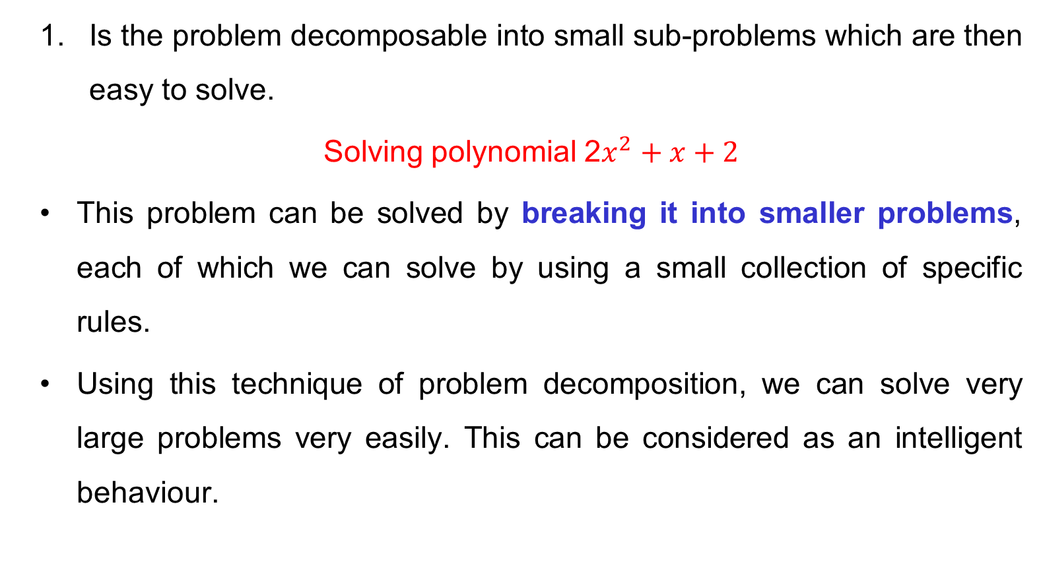
Problem characterization 1

Slide 22
Problem characterization 2
2. Can Solution steps be ignored or undone?
Suppose we are trying to prove a mathematical theorem: first we proceed considering that proving a lemma will be useful. Later we realize that it is not at all useful. We start with another one to prove the theorem. Here we simply ignore the first method.
Consider the 8-puzzle problem to solve: we make a wrong move and realize that mistake. But here, the control strategy must keep track of all the moves, so that we can backtrack to the initial state and start with some new move.

Slide 23
Problem characterization 2 (Contd.)
2. Can Solution steps be ignored or undone?
Consider the problem of playing chess. Here, once we make a move we never recover from that step. These problems are illustrated in the three important classes of problems mentioned below:
Ignorable, in which solution steps can be ignored. e.g: Theorem Proving
Recoverable, in which solution steps can be undone. e.g: 8-Puzzle
Irrecoverable, in which solution steps cannot be undone. e.g: Chess

Slide 24
Problem characterization 3
3. Is the universe of the problem predictable?
Consider the 8-Puzzle problem. Every time we make a move, we know exactly what will happen.
This means that it is possible to plan an entire sequence of moves and be confident what the resulting state will be.
We can backtrack to earlier moves if they prove unwise.
Suppose we want to play Bridge. We need to plan before the first play, but we cannot play with certainty. So, the outcome of this game is very uncertain.
In case of 8-Puzzle, the outcome is very certain. To solve uncertain outcome problems, we follow the process of plan revision as the plan is carried out and the necessary feedback is provided. The disadvantage is that the planning in this case is often very expensive.

Slide 25
Problem characterization 4
4. Is a good solution to the problem a absolute or relative?
Consider the problem of answering questions based on a database of simple facts such as the following:
X was a man.
X was a worker in a company.
X was born in 1905.
All men are mortal.
All workers in a factory died when there was an accident in 1952.
No mortal lives longer than 100 years
Suppose we ask a question: ‘Is X alive?’

Slide 26
Problem characterization 4 (Contd.)
There are two ways to answer the question shown below:
Method I:
1. X was a man.
2. X was born in 1905.
3. All men are mortal.
4. Now it is 2008, so X’s age is 103 years.
5. No mortal lives longer than 100 years.
Method II:
1. X is a worker in the company.
2. All workers in the company died in 1952.
Answer: So X is not alive. It is the answer from the above methods

Slide 27
Problem characterization 5
5. Is the solution to the problem a state or a path?
A path-solution problem can be reformulated as a state-solution problem by describing a state as a partial path to a solution. The question is whether that is natural or not.

Slide 28
Problem characterization 6
6. What is the role of knowledge in solving a problem using AI?
Playing a chess: Consider again the problem of playing chess. Suppose you had unlimited computing power available. How much knowledge would be required by a perfect program?
Reading Newspaper: Now consider the problem of scanning daily newspapers to decide which are supporting the Democrats and which are supporting the Republicans in some upcoming election. Again assuming unlimited computing power, how much knowledge would be required by a computer trying to solve this problem?

Slide 29
Problem characterization 7
7. Does the task of solving a problem require human interactions?
Sometimes it is useful to program computers to solve problems in ways that the majority of people would not be able to understand.
This is fine if the level of the interaction between the computer and its human users is problem-in solution-out. But increasingly we are building programs that require intermediate interaction with people, both to provide additional input to the program and to provide additional reassurance to the user.
The solitary problem, in which there is no intermediate communication and no demand for an explanation of the reasoning process.
The conversational problem, in which intermediate communication is to provide either additional assistance to the computer or additional information to the user.

Slide 30
Question
Analyze each of them with respect to the seven problem characteristics:
8-puzzle
Tower of Hanoi
Problem characteristic | Satisfied | Reasons

Slide 31
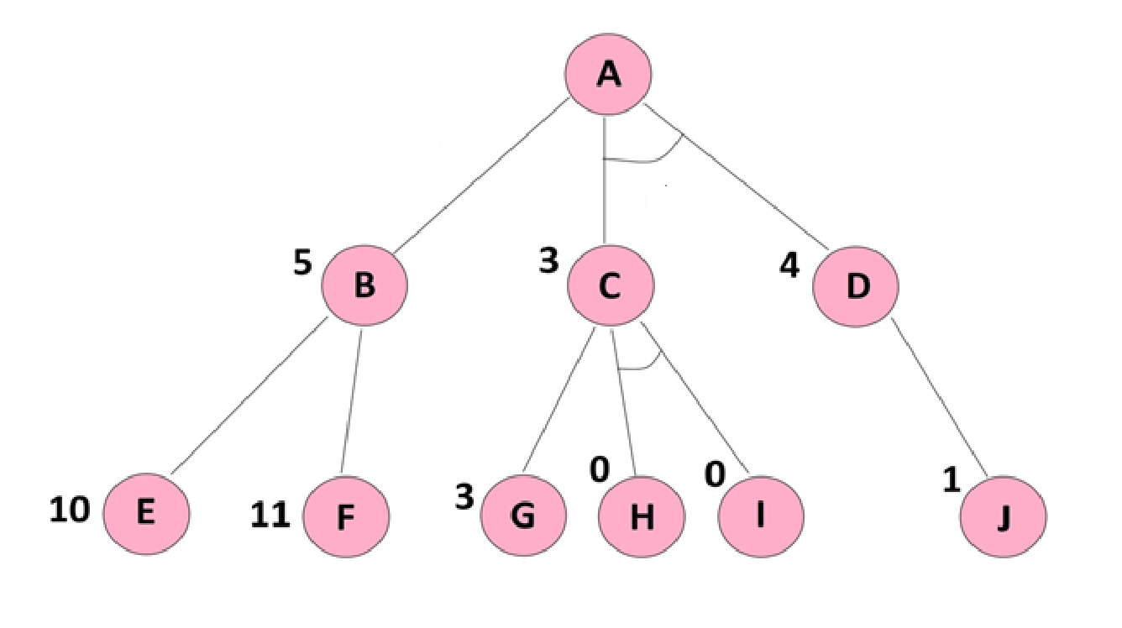
Problem Reduction
In problem reduction space, the nodes represents problems to be solved or goals to be achieved, and the edges represents the decomposition of the problem into subproblems.
Via And and Or graphs.

Slide 32
State Space Search
3 | 4 | 2
7 |  | 6
5 | 1 | 8
1 | 2 | 3
8 |  | 4
7 | 6 | 5
Start State
Goal State

Slide 33
Searching types
Uniformed: A blind search, the search algorithm produces the search tree without using any domain knowledge, which is a brute force in nature. e.g. BFS, DFS.
Only start and goal state is known
Time consuming
More time and space complexity
Informed: Heuristic Approaches
Quick solution
Less time and space complexity
E.g. A*

Slide 34
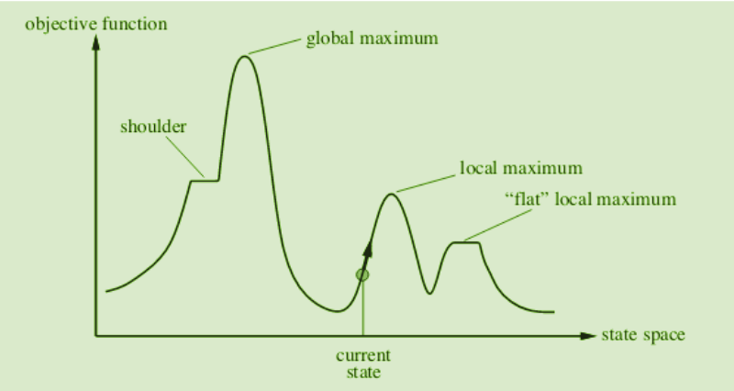
Hill Climbing algorithm
Considered greedy approach.
The algorithm never reverses the earlier decision (no backtracking)
State Space in hill climbing:
Local maxima
Global maximum
Current state
Flat local maximum
Shoulder

Slide 35
Types of Hill Climbing algorithm
Simple Hill Climbing: It only checks its one successor state if found best it stops.
Steepest-Ascent hill-climbing: It examines all the neighboring nodes and select one neighbours node which is closet to the goal state.
Stochastic hill climbing: It selects one neighbours node randomly and decides whether to choose it as a current-state or examine another state.

Slide 36
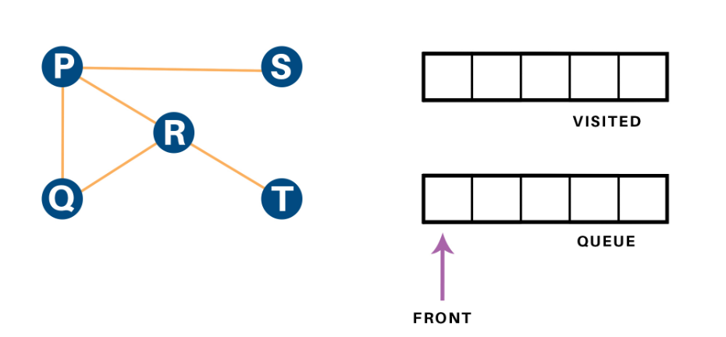
Breadth First Search
Uniformed search technique
Use data structure Queue (FIFO).
Shallowest node.

Slide 37
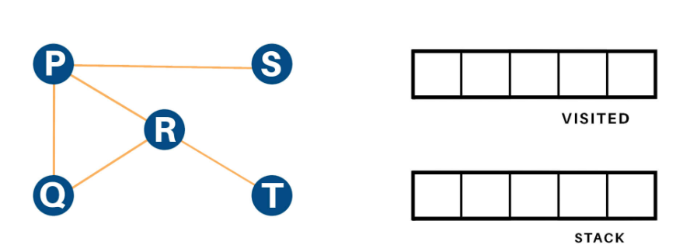
Depth First Search
Uniformed search technique
Use data structure Stack (LIFO).
Deepest node.

Slide 38
A* algorithm
Informed searching.
Finds the shortest path between two points.
It finds the optimal path.
It uses weighted graphs for its implementation.
It is said to be a optimal and complete algorithm.
Optimal : As it finds least cost outcome of a problem.
Complete: As it finds all the possible outcome of the problem.

Slide 39
A* algorithm (contd.)
Applications of A*: Robotics, video games, Logistics.
It is an extension of Dijkstra’s algorithm.
Instead of using priority queue to store all elements, we use heaps to store them.
It takes more space to store all the paths and takes more time to find them out.
It also uses heuristic function to provide additional information regarding how far are we from the goal.

Slide 40
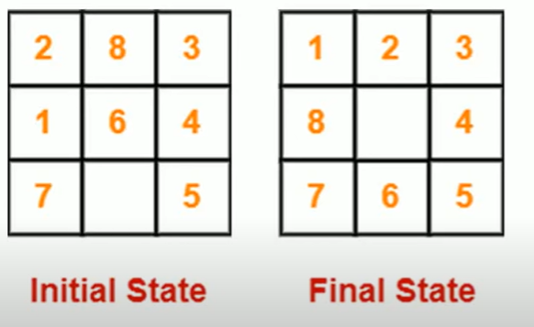
A* algorithm (contd.)

Slide 41
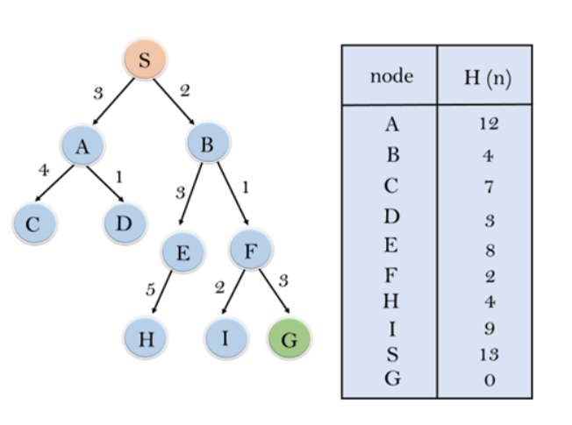
Best First search
Informed Search, based upon heuristic approaches.
Uses Priority Queue to store cost of nodes.
A greedy search algorithm.
Priority queue containing initial states.

Slide 42
Mean End Analysis (MEA)
Means-Ends Analysis is problem-solving techniques used in Artificial intelligence for limiting search in AI programs.
Means end analysis uses actions (means) to tell you how to achieve your goal (the end).
Means-ends analysis is a version of divide-and-conquer.
The difference between the two is that divide-and-conquer is purely recursive: the subproblems that are solved are always of the same type.
Means-ends analysis is more flexible, and less obviously recursive, because the subproblems that are defined for it need not all be of the same type.

Slide 43
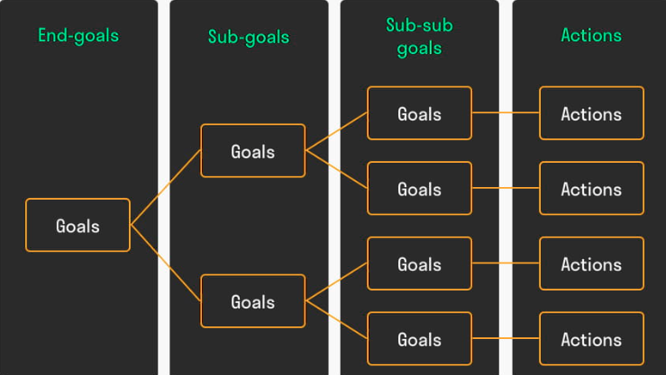
Mean End Analysis (MEA) contd.

Slide 44
Ethics of AI
AI ethics are the study of the moral and ethical considerations involved in developing and using AI.
This field focuses on:
How can we make sure that autonomous machines act following our values?
How can we ensure that they have less probability of harming humans than other technologies?
What is our responsibility as designers and users of ethical AI systems?
It is also termed as machine ethics/computational ethics.

Slide 45
Ethics of AI (Contd.)
AI ethics revolves around four main areas:
Safety: This refers to how well AI can avoid harming humans. (Not causing human harm or using offensive language)
Security: How well AI can prevent other systems from attacking it or taking advantage.
Privacy: How much information an AI knows about you, where it gets data from, how it stores that information.
Fairness: This refers to whether or not your rights as a consumer are being protected when interacting with a company.
As a new field of AI, ethics is still in development phase.
It is a challenge in AI to know whether a developed program is acting ethically or not.

Slide 46
Closing Remarks
General questions you might have
Do we want to build a computer that will be like us?
If so, what do we need them for?
What will the human-computers do for humanity?
No answers to these questions…yet research and achievement continues to progress each year - We must wait and see what the future holds

Slide 47
Thanks

